Slide 1
Chapter 9: Subnetting IP Networks
Introduction to Networks
Notes:
Cisco Networking Academy program
Introduction to Networks
Chapter 9: Subnetting IP Networks

Slide 2
Chapter 9
9.0 Introduction
9.1 Subnetting an IPv4 Network
9.2 Addressing Schemes
9.3 Design Considerations for IPv6
9.4 Summary
Notes:
Chapter 9

Slide 3
Chapter 9: Objectives
Upon completion of this chapter, you will be able to:
Explain why routing is necessary for hosts on different networks to communicate.
Describe IP as a communication protocol used to identify a single device on a network.
Given a network and a subnet mask, calculate the number of host addresses available.
Calculate the necessary subnet mask in order to accommodate the requirements of a network.
Describe the benefits of variable length subnet masking (VLSM).
Explain how IPv6 address assignments are implemented in a business network.
Notes:
Chapter 9

Slide 4
9.1 Subnetting an IPv4 Network
Notes:
9.1 Subnetting an IPv4 Network

Slide 5
Network Segmentation Reasons for Subnetting
Subnetting is the process of segmenting a network into multiple smaller network spaces called subnetworks or subnets.
Large networks must be segmented into smaller subnetworks, creating smaller groups of devices and services to:
Control traffic by containing broadcast traffic within each subnetwork.
Reduce overall network traffic and improve network performance.
Communication Between Subnets
A router is necessary for devices on different networks and subnets to communicate.
Each router interface must have an IPv4 host address that belongs to the network or subnet that the router interface is connected.
Devices on a network and subnet use the router interface attached to their LAN as their default gateway.
Notes:
9.1.1.1 Reasons for Subnetting
9.1.1.2 Communication Between Subnets

Slide 6
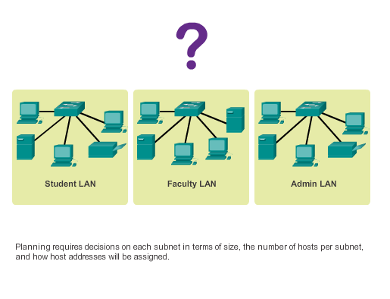
IP Subnetting is FUNdamental The Plan
Planning the Network
Notes:
9.1.2.1 The Plan
9.1.2.2 The Plan - Address Assignment

Slide 7
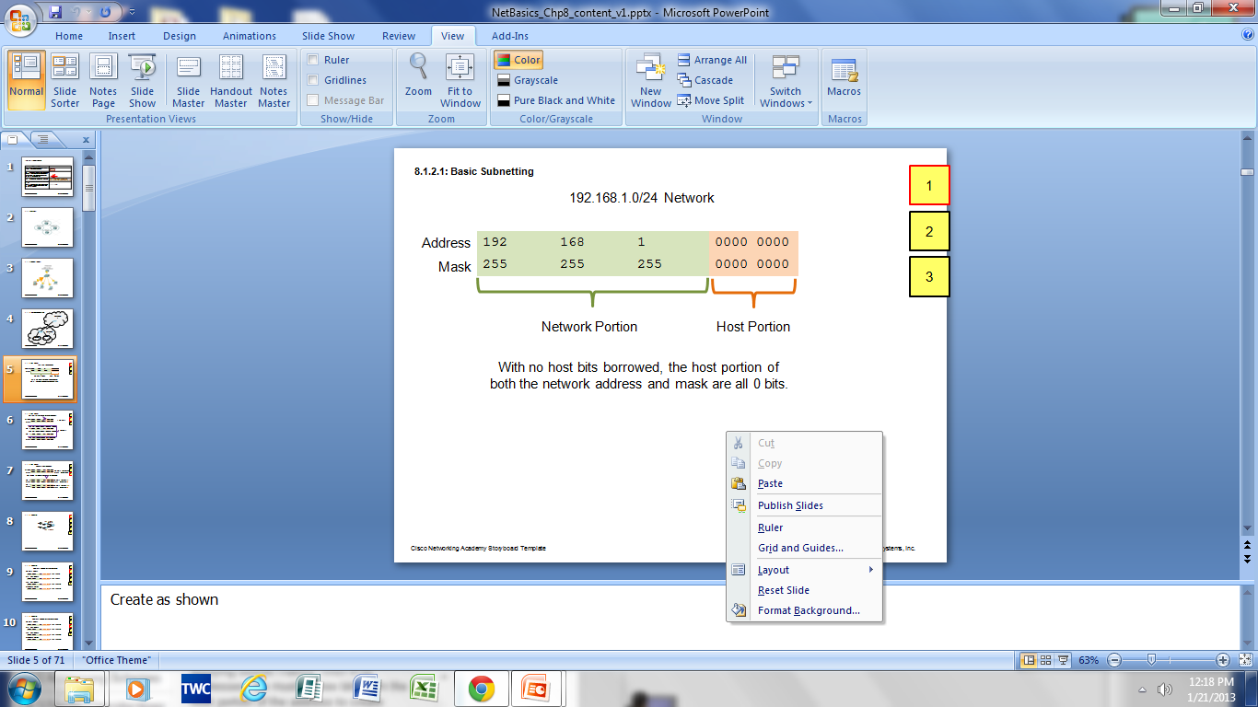
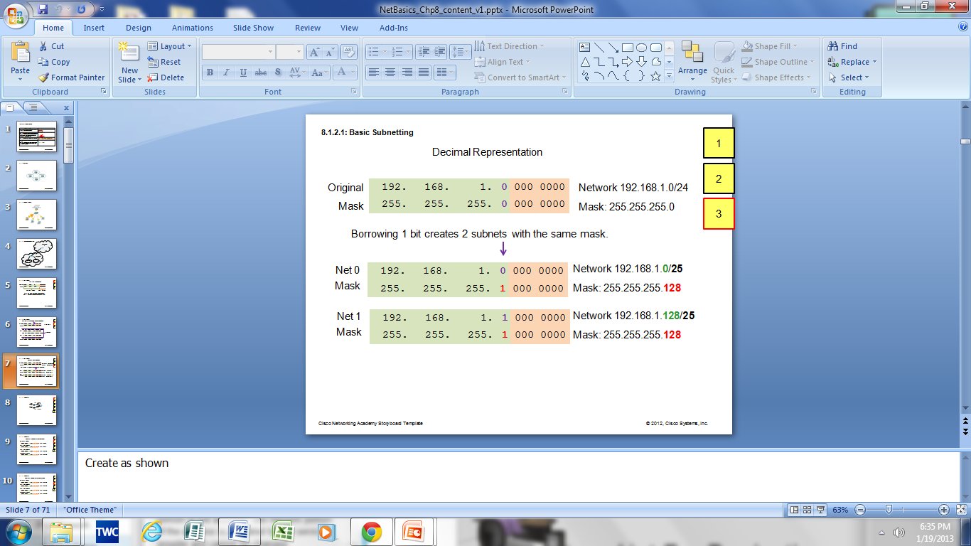
Subnetting an IPv4 Network Basic Subnetting
Borrowing Bits to Create Subnets
Borrowing 1 bit 2¹ = 2 subnets
Borrowing 1 Bit from the host portion creates 2 subnets with the same subnet mask
Subnet 0
Network 192.168.1.0-127/25
Mask: 255.255.255.128
Subnet 1
Network 192.168.1.128-255/25
Mask: 255.255.255.128
Notes:
9.1.3.1 Basic Subnetting

Slide 8
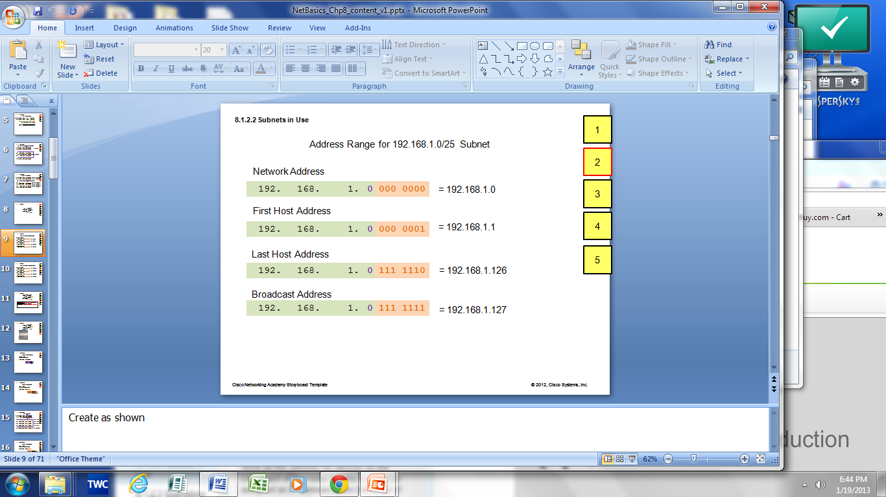
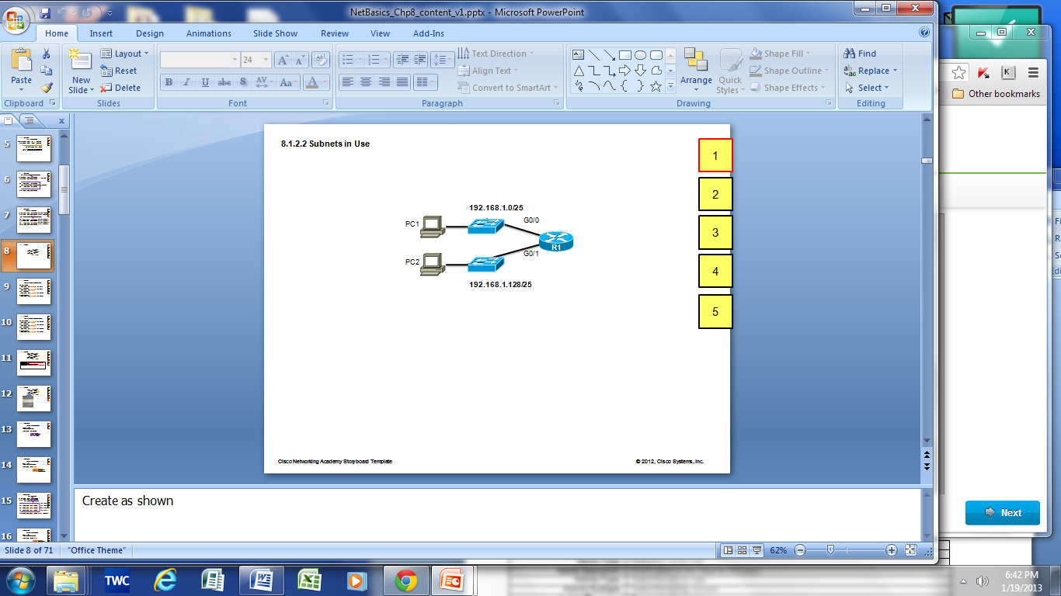

Subnetting an IPv4 Network Subnets in Use
Subnets in Use
Subnet 0
Network 192.168.1.0-127/25
Subnet 1
Network 192.168.1.128-255/25
Notes:
9.1.3.2 Subnets in Use

Slide 9
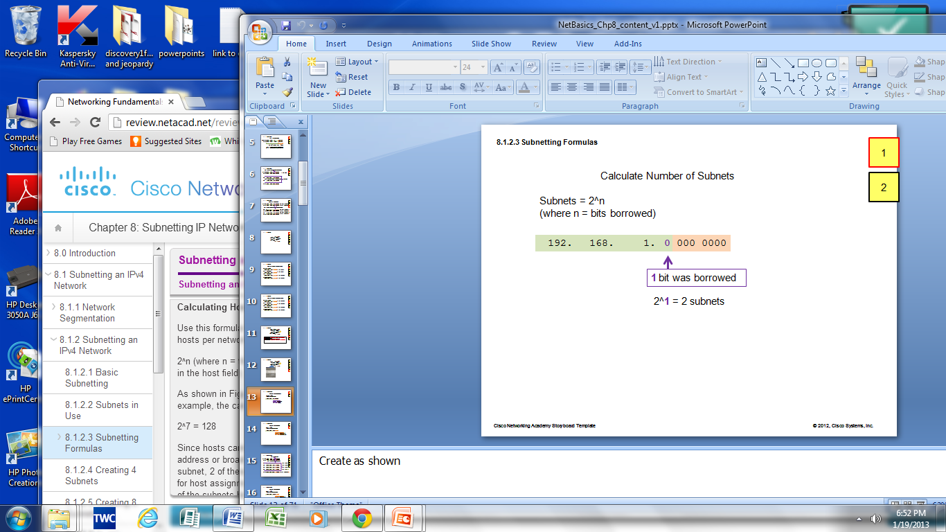
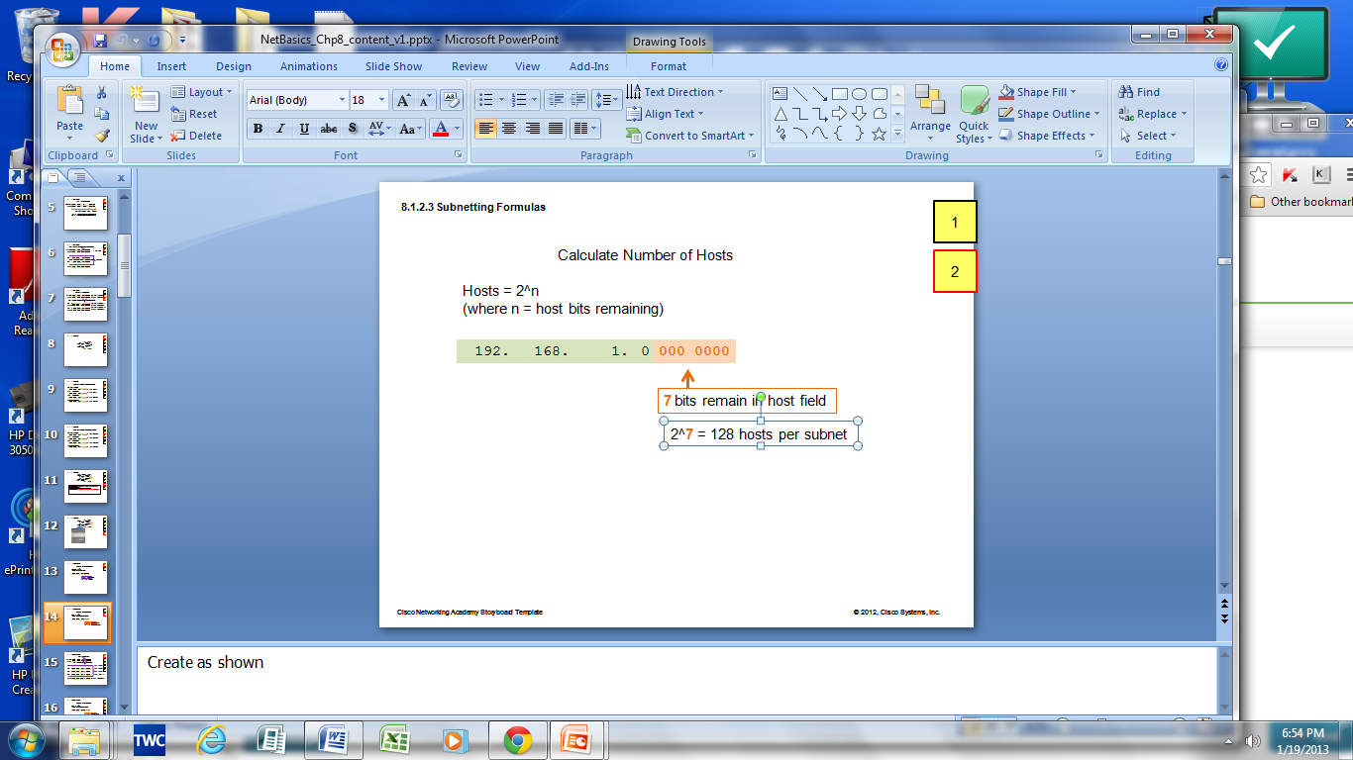
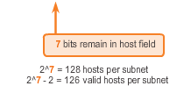
Subnetting an IPv4 Network Subnetting Formulas
Calculate number of subnets
Calculate number of hosts
Notes:
9.1.3.3 Subnetting Formulas

Slide 10
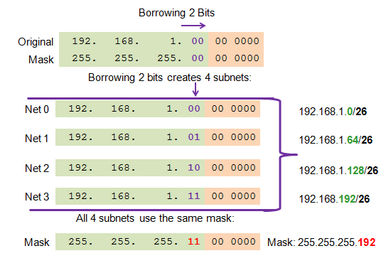
Subnetting an IPv4 Network Creating 4 Subnets
Borrowing 2 bits to create 4 subnets. 2² = 4 subnets
Creating 4 Subnets
Notes:
9.1.3.4 Creating 4 subnets

Slide 11
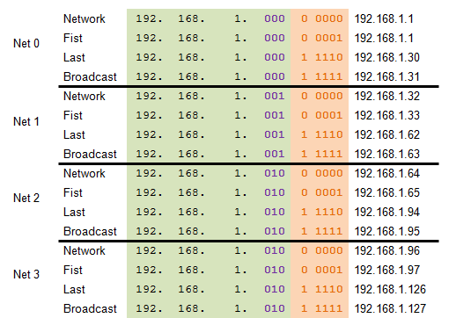
Subnetting an IPv4 Network Creating Eight Subnets
Borrowing 3 bits to Create 8 Subnets. 2³ = 8 subnets
Notes:
9.1.3.5 Creating 8 subnets

Slide 12
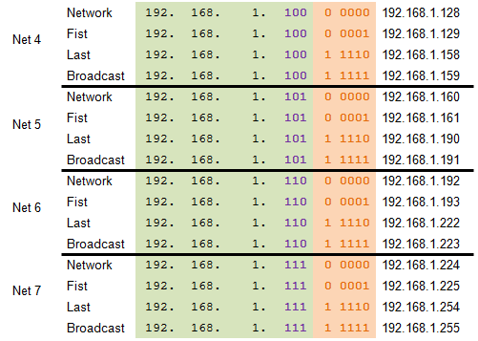
Subnetting an IPv4 Network Creating Eight Subnets (Cont.)
Notes:
9.1.3.5 Creating 8 Subnets (Cont.)

Slide 13
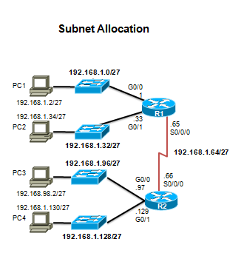
Subnetting an IPv4 Network Creating Eight Subnets (Cont.)
Notes:
9.1.3.5 Creating 8 Subnets (Cont.)

Slide 14
Determining the Subnet Mask Subnetting Based on Host Requirements
Two considerations when planning subnets:
Number of subnets required
Number of host addresses required
Formula to determine number of usable hosts: 2^n-2
2^n (where n is the number of remaining host bits) is used to calculate the number of hosts.
-2 (The subnetwork ID and broadcast address cannot be used on each subnet.)
Notes:
9.1.4.1 Subnetting based on Host Requirements

Slide 15
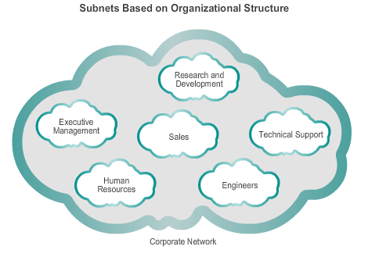
Determining the Subnet Mask Subnetting Network-Based Requirements
Calculate the number of subnets:
2^n (where n is the number of bits borrowed)
Subnet needed for each department.
Notes:
9.1.4.2 Subnetting Network-Based Requirements

Slide 16
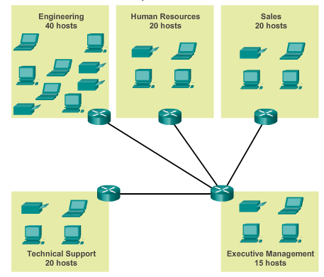
Determining the Subnet Mask Subnetting To Meet Network Requirements
Balance the required number of subnets and hosts for the largest subnet.
Design the addressing scheme to accommodate the maximum number of hosts for each subnet.
Allow for growth in each subnet.
Notes:
9.1.4.3 Subnetting to Meet Network Requirements

Slide 17
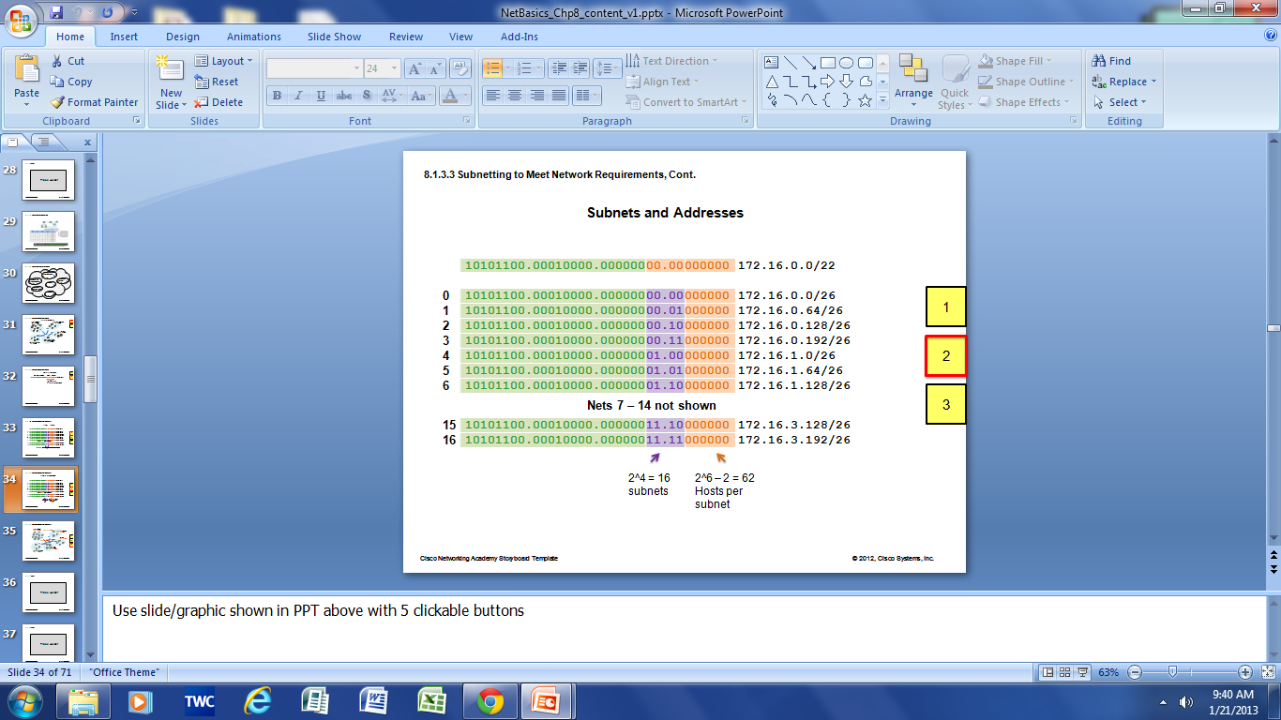
Determining the Subnet Mask Subnetting To Meet Network Requirements
Notes:
9.1.4.4 Subnetting to Meet Network Requirements (Cont.)

Slide 18
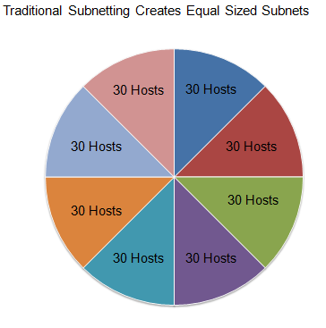
Benefits of Variable Length Subnet Masking Traditional Subnetting Wastes Addresses
Traditional subnetting – Uses the same number of addresses is allocated for each subnet.
Subnets that require fewer addresses have unused (wasted) addresses; for example, WAN links only need two addresses.
Notes:
9.1.4.1 Traditional Subnetting Wastes Addresses

Slide 19
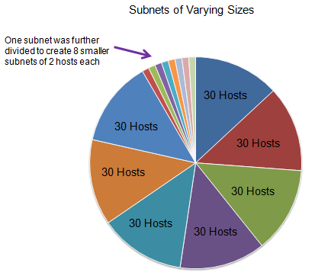
Benefits of Variable Length Subnet Masking Variable Length Subnet Masks (VLSM)
The variable-length subnet mask (VLSM) or subnetting a subnet provides more efficient use of addresses.
VLSM allows a network space to be divided in unequal parts.
Subnet mask varies, depending on how many bits have been borrowed for a particular subnet.
Network is first subnetted, and then the subnets are resubnetted.
Notes:
9.1.4.2 Variable Length Subnet Masks (VLSM)

Slide 20
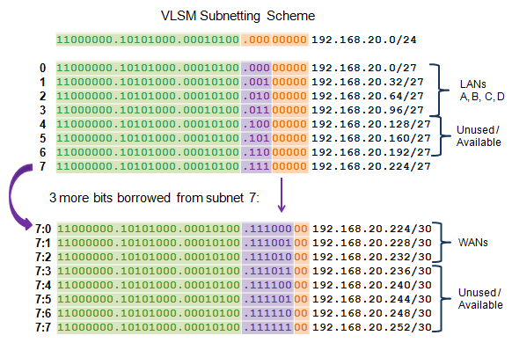
Benefits of Variable Length Subnet Masking Basic VLSM
Notes:
9.1.5.3 Basic VLSM

Slide 21
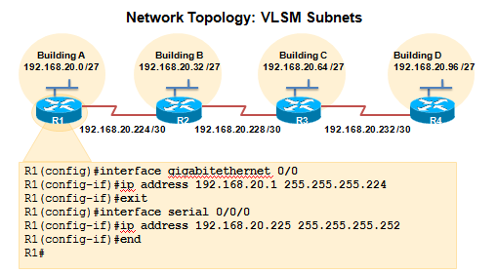
Benefits of Variable Length Subnet Masking VLSM in Practice
Using VLSM subnets, the LAN and WAN segments in example below can be addressed with minimum waste.
Each LANs will be assigned a subnet with /27 mask.
Each WAN link will be assigned a subnet with /30 mask.
Notes:
9.1.5.4 VLSM in Practice

Slide 22
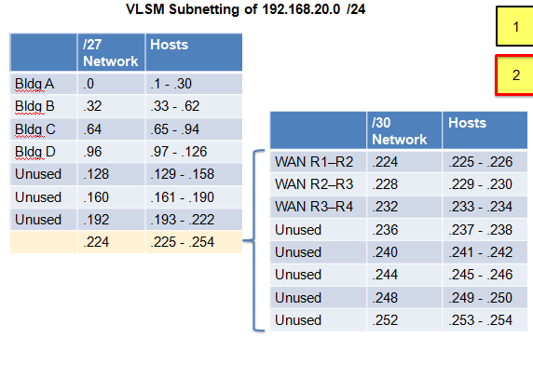
Benefits of Variable Length Subnet Masking VLSM Chart
Notes:
9.1.5.5 VLSM Chart

Slide 23
9.2 Addressing Schemes
Notes:
9.2 Addressing Schemes

Slide 24
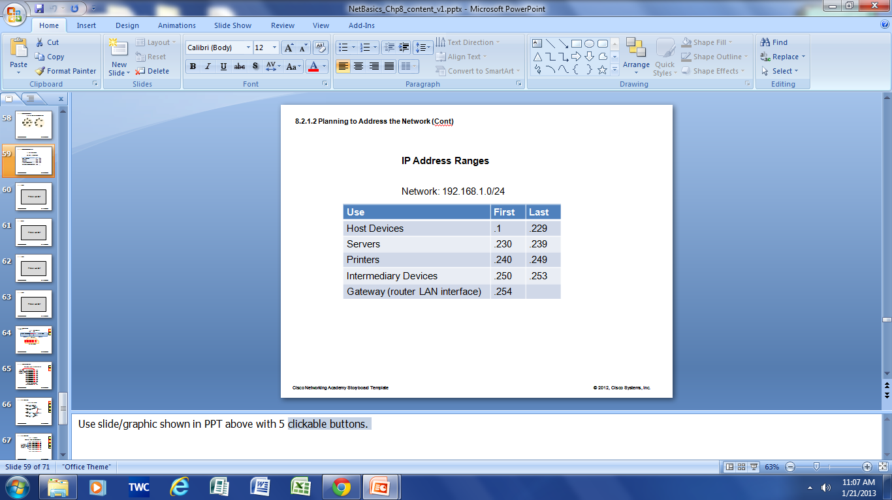
Structured Design Planning to Address the Network
Allocation of network addresses should be planned and documented for the purposes of:
Preventing duplication of addresses
Providing and controlling access
Monitoring security and performance
Client addresses – Usually dynamically assigned using the Dynamic Host Configuration Protocol (DHCP).
Sample Network Addressing Plan
Notes:
9.2.1.1 Planning to Address the Network
9.2.1.2 Assigning Addresses to Devices

Slide 25
9.3 Design Considerations for IPv6
Notes:
9.3 Design Considerations for IPv6

Slide 26
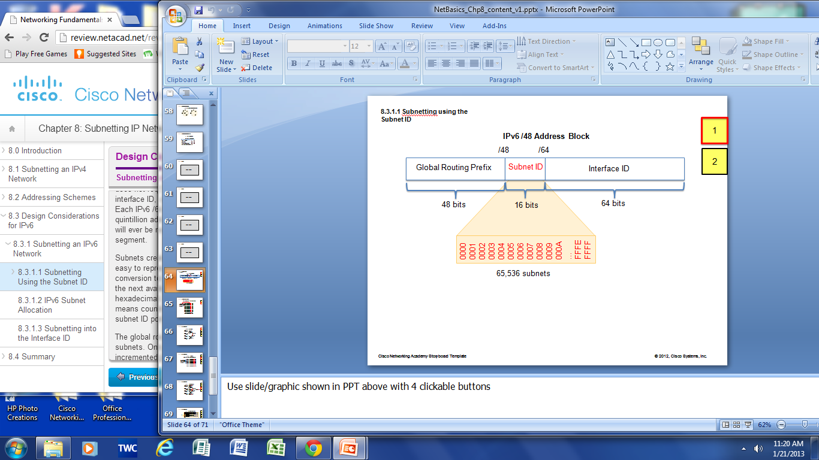
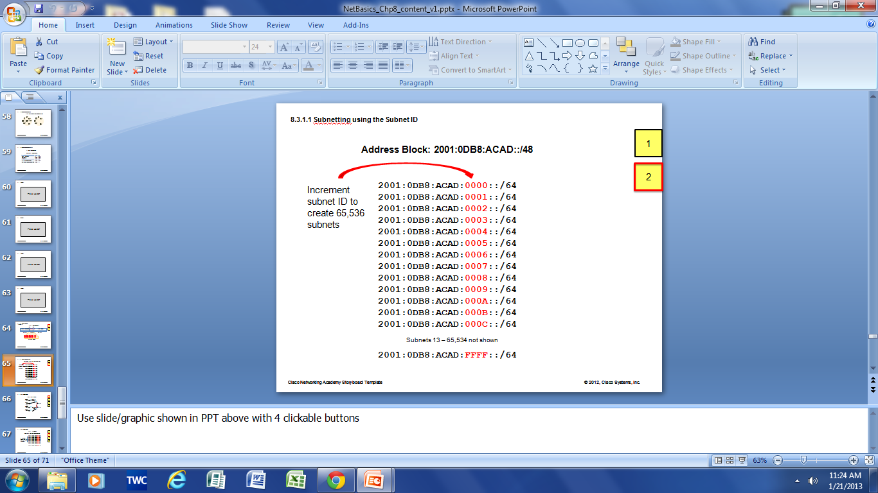
Subnetting an IPv6 Network Subnetting Using the Subnet ID
An IPv6 Network Space is subnetted to support hierarchical, logical design of the network
Notes:
9.3.1.1 Subnetting Using the Subnet ID

Slide 27
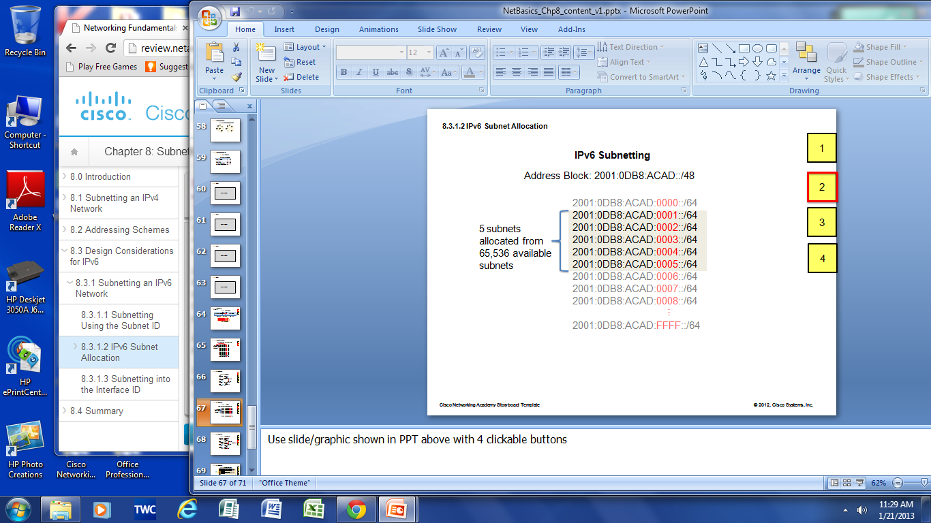
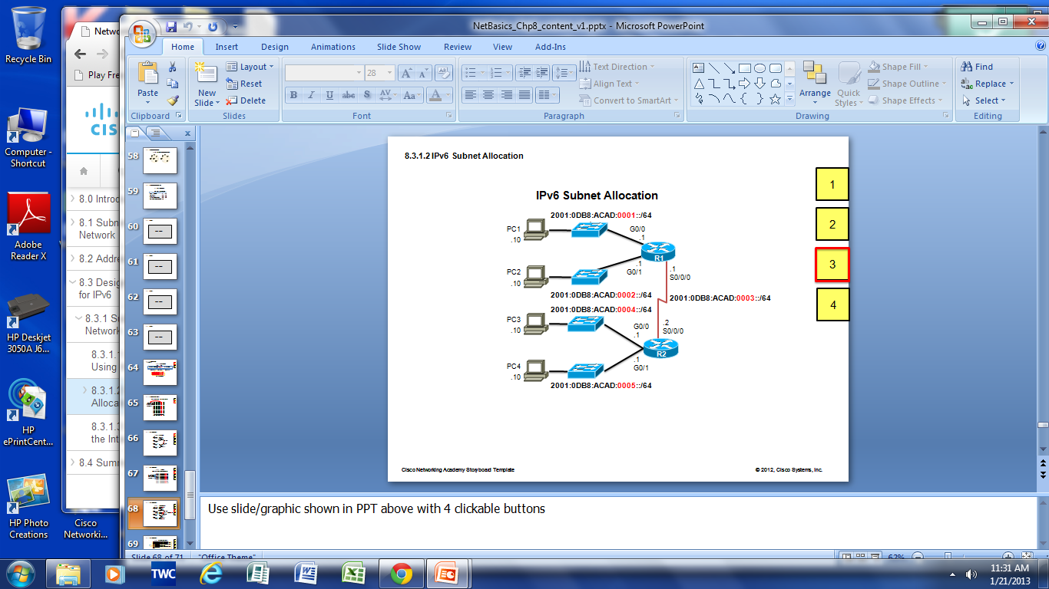
Subnetting an IPv6 Network IPV6 Subnet Allocation
Notes:
9.3.1.2 IPv6 Subnet Allocation

Slide 28
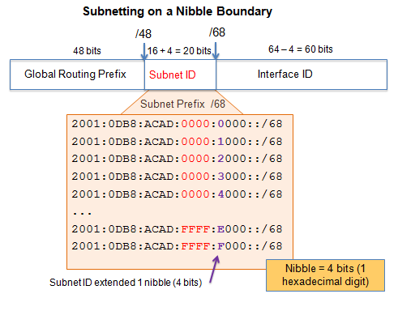
Subnetting an IPv6 Network Subnetting into the Interface ID
IPv6 bits can be borrowed from the interface ID to create additional IPv6 subnets.
Notes:
9.3.1.3 Subnetting into the Interface ID

Slide 29
9.3 Summary
Notes:
9.3 Summary

Slide 30
Chapter 9: Summary
In this chapter, you learned that:
Subnetting is the process of segmenting a network, by dividing it into multiple smaller network spaces.
Subnetting a subnet, or using VLSM, was designed to avoid wasting addresses.
IPv6 address space is subnetted to support the hierarchical, logical design of the network.
Size, location, use, and access requirements are all considerations in the address planning process.
IP networks must be tested to verify connectivity and operational performance.
Notes:
Chapter 9 Summary

Slide 31


